Slide 1
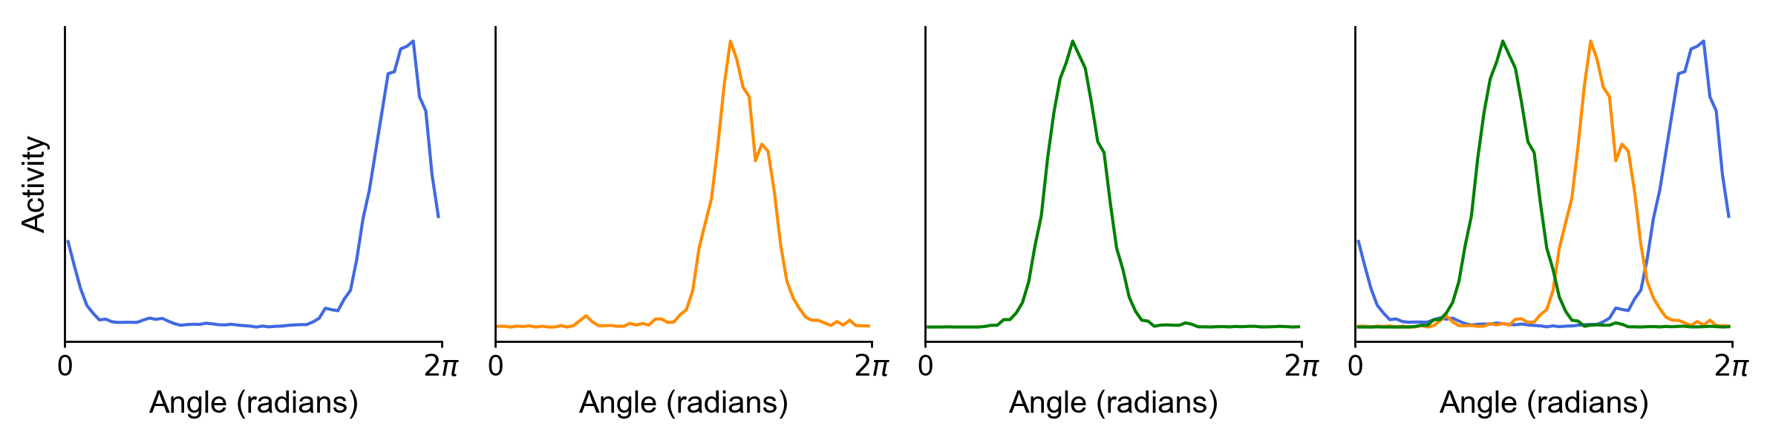
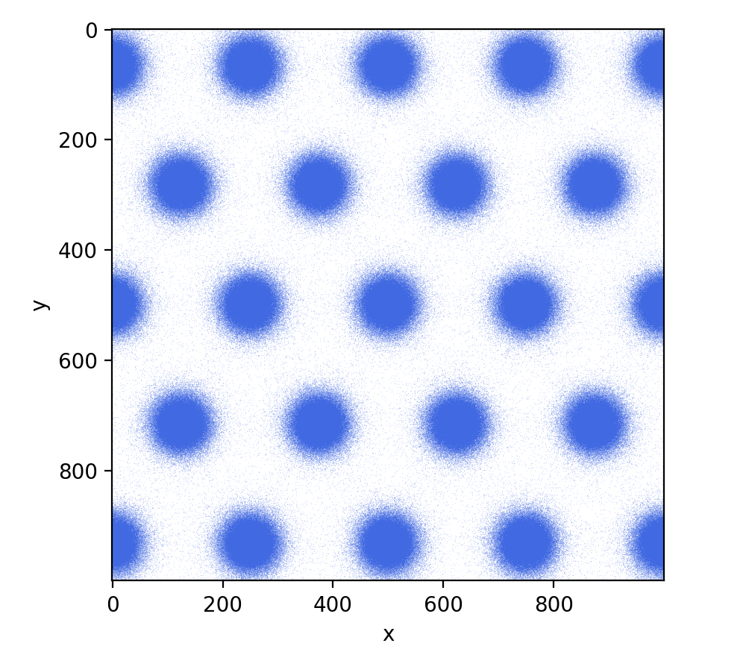
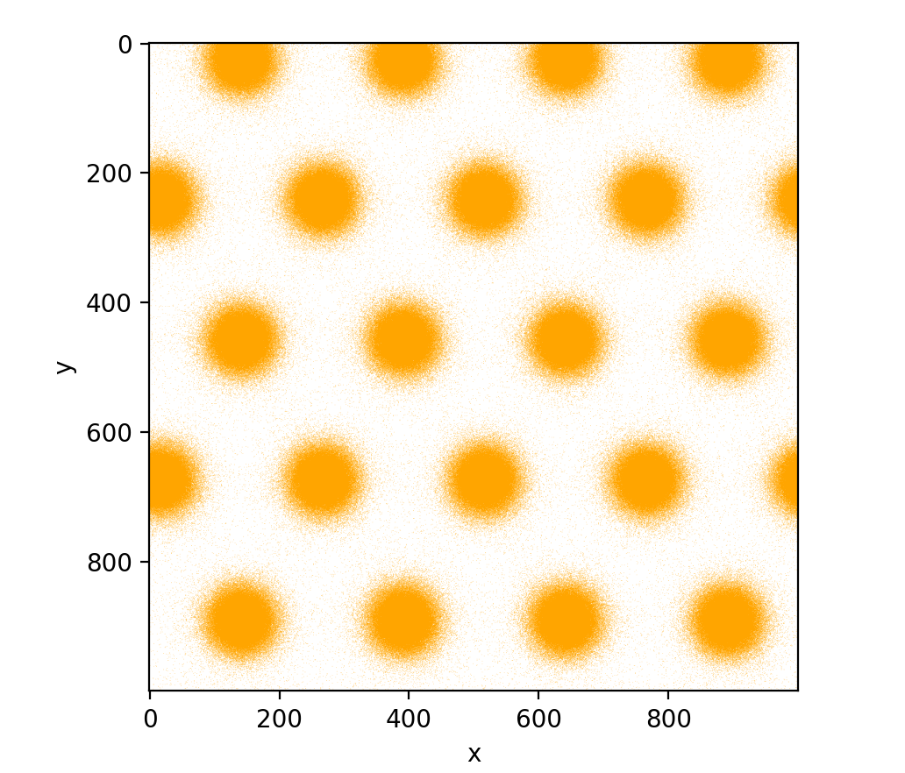
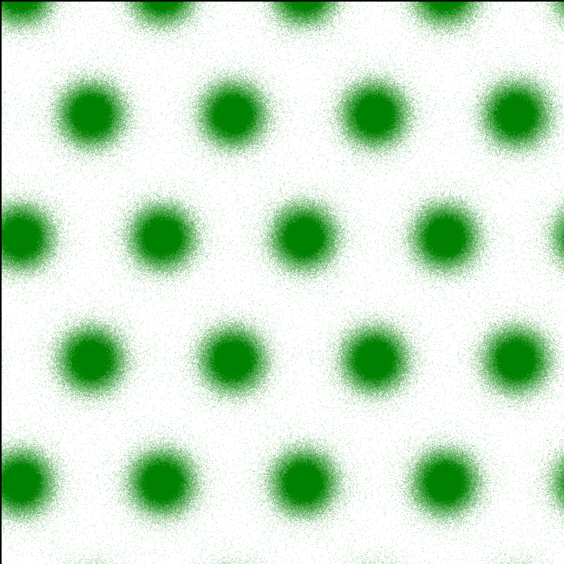
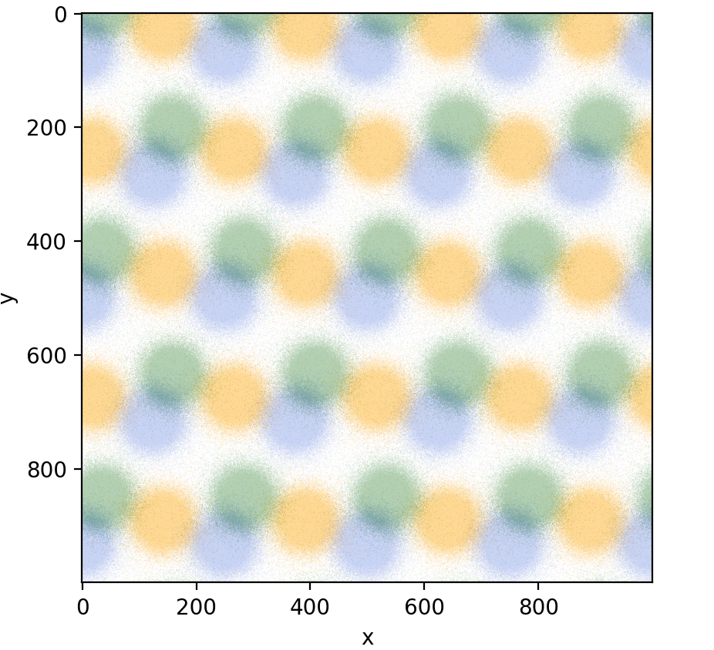
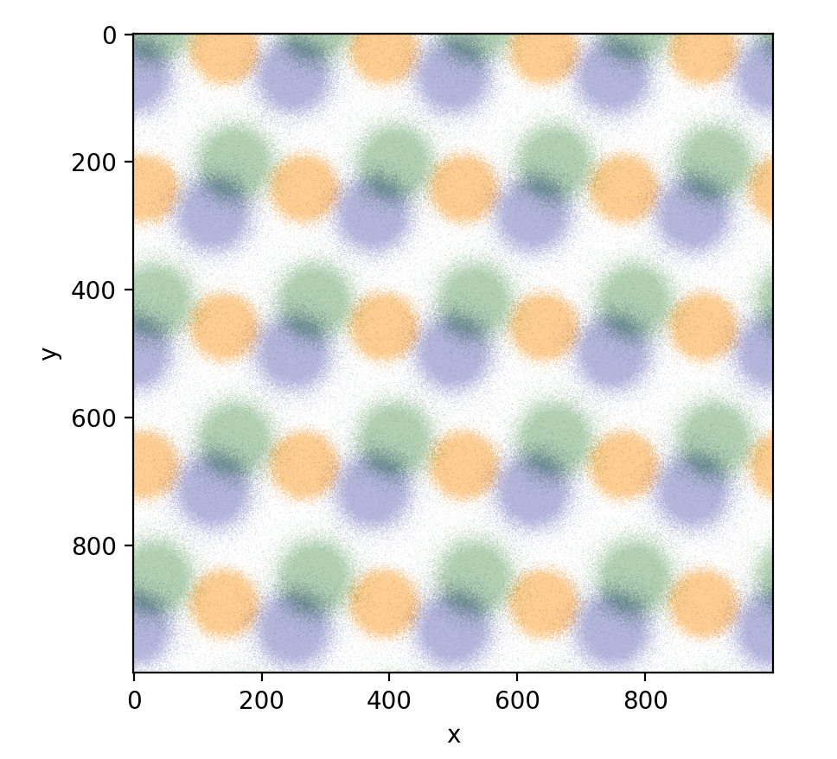
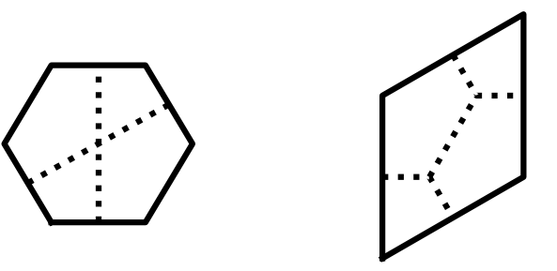
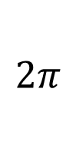


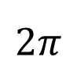
Δθ
HD cell 1
HD cell 2
HD cell 3
Overlay
A
grid cell 1
grid cell 2
grid cell 3
Overlay
B
$$2π$$
Δg
$$0$$
$$0$$
$$2π$$
Physical space
C
Hexagon unit
Rhombus unit
c
a
d
b
b
a
c
d

